Slide 1





B25 FIT LEVEL 01 PROJECT
Smart Recovery Companion
A Microcontroller-Based Patient Comfort and Care Automation System
Prepared by
Supervised by
[Index No.] [Initials & Surname] — BSc (Hons) in [Degree Programme Name]
[Index No.] [Initials & Surname] — BSc (Hons) in [Degree Programme Name]
[Index No.] [Initials & Surname] — BSc (Hons) in [Degree Programme Name]
[Index No.] [Initials & Surname] — BSc (Hons) in [Degree Programme Name]
[Index No.] [Initials & Surname] — BSc (Hons) in [Degree Programme Name]
[Supervisor's Full Name]
Department of [Department Name]
Faculty of Information Technology | Academic Year 2026

Slide 2
1. Introduction
Patients recovering at home from illness, fever, flu, or surgery need continuous comfort, hydration, medication adherence, and safety support — but round-the-clock caregiver presence is not always possible.
This project proposes a microcontroller-based assistant that automates everyday recovery-support tasks: environmental comfort, medicine reminders, hydration tracking, and safety alerts.
The system deliberately avoids diagnosing any illness. It does not interpret vital signs or medical data — it only automates supportive, non-clinical comfort and care routines, keeping the scope realistic for a Level 01 embedded systems project.
Comfort
Room temp & humidity
Adherence
Medicine reminders
Hydration
Water intake tracking
Safety
Fall & emergency alerts
Smart Recovery Companion
2

Slide 3

2. Aim and Objectives
Aim: To design and implement a microcontroller-based, non-diagnostic comfort and care automation system that supports a patient's recovery at home through environmental control, medication reminders, hydration tracking, and emergency alerts to caregivers.
1
Environmental Comfort
2
Medicine Reminder
3
Hydration Monitoring
Sense room temperature & humidity and automatically control a fan and humidifier.
Use an RTC schedule to trigger a servo-based pill dispenser, display, and buzzer alert.
Track water bottle weight with a load cell and prompt the patient if intake is low.
4
Safety & Emergency
5
Central Integration
6
Caregiver Notification
Detect falls with an accelerometer and provide a manual emergency button.
Unify all subsystems on one ESP32 controller with a local OLED status dashboard.
Send Wi-Fi based alerts (Telegram / SMS / Email) for missed doses, falls, or emergencies.
Smart Recovery Companion
3

Slide 4


3. Problem and Proposed Solution
The Problem
Proposed Solution
Family caregivers cannot monitor a recovering patient 24/7.
Patients often forget prescribed medicine times and become dehydrated during illness.
Room humidity and temperature swings cause dry throat, coughing, and discomfort.
A weak or recovering patient may fall or need help without anyone noticing in time.
Existing smart-health devices usually attempt medical diagnosis, which requires regulatory approval and clinical validation, making them unsuitable for a student embedded-systems project.
An integrated, ESP32-based "Smart Recovery Companion" that automates comfort and care routines without interpreting any medical/vital-sign data.
DHT22 + relay-controlled fan/humidifier keep the room within a comfortable humidity and temperature band automatically.
An RTC-scheduled servo pill dispenser and buzzer/OLED reminders support medicine adherence.
A load-cell-based bottle monitor and MPU6050 fall detector add hydration and safety support.
Wi-Fi connectivity pushes real-time alerts to a caregiver's phone via Telegram/SMS/Email whenever attention is needed.
Smart Recovery Companion
4

Slide 5
4. Implementation — Complete Block Diagram
SENSING LAYER (Inputs)
ACTUATION & OUTPUT LAYER
DHT22 — Temp. & Humidity
Relay + Fan — Cooling
HX711 + Load Cell — Bottle Weight
Relay + Ultrasonic Humidifier
ESP32
Main Controller
(Wi-Fi + Bluetooth)
HC-SR04 — Tank / Bin Level
Servo Motor — Pill Dispenser
MPU6050 — Fall Detection
0.96" OLED — Status Display
MQ135 — Air Quality
Buzzer — Audible Alerts
Wi-Fi Module
(on-board)
Push Button — Emergency / Snooze
Cloud / MQTT
Broker
Telegram Bot /
SMS Gateway
Caregiver's
Smartphone
All sensor inputs and actuator outputs are coordinated by a single ESP32, which also pushes real-time alerts to the caregiver over Wi-Fi.
Smart Recovery Companion
5

Slide 6




4. Implementation — Medicine Reminder & Dispenser Flow
RTC (DS3231)
ESP32 Logic
Servo Motor
Buzzer + OLED
Push Button
Checks scheduled dose time
Matches time to schedule
Rotates dispenser compartment
"Time for medicine" alert
Patient confirms dose taken
If missed: if the button is not pressed within a configurable window (e.g. 10 minutes) after the buzzer sounds, the ESP32 sends a "missed dose" notification to the caregiver's phone over Wi-Fi (Telegram/SMS), without making any medical judgement about the patient's condition.
Compartment count and dosing schedule are configurable via firmware before deployment for a specific patient.
Smart Recovery Companion
6

Slide 7
4. Implementation — Comfort & Safety Subsystem Logic
Environmental Comfort Control
Fall Detection & Emergency Flow
Humidity < 45% RH
Humidifier relay ON
1
MPU6050 continuously streams acceleration data to the ESP32
Humidity > 60% RH
Humidifier relay OFF
2
Firmware compares readings against a sudden-impact / free-fall threshold
Temperature > 28°C
Fan relay ON
3
Threshold exceeded → local buzzer sounds immediately
Temperature < 22°C
Heater relay ON
Tank level low (ultrasonic)
Buzzer + OLED refill alert
4
Emergency push-button available for manual trigger at any time
5
ESP32 sends a Wi-Fi alert (Telegram/SMS) with a timestamp to the caregiver
Smart Recovery Companion
7

Slide 8

4. Implementation — 3D View of the Final Product
Insert your hand-drawn sketch or CAD render here
This slide is intentionally left as a template — the brief requires an original hand-drawn sketch or a 3D model made in Blender / Fusion 360 / SolidWorks, and explicitly excludes AI-generated images.
Design the enclosure to house: ESP32 + wiring, OLED display window, pill-dispenser compartments with a rotating servo disk, DHT22 vent, buzzer, and an external emergency button.
Label every key dimension (overall L × W × H, compartment diameter, vent openings) and annotate each major part.
Overall: ~180 × 120 × 90 mm
Dispenser disk: Ø90 mm, 4 compartments
OLED window: 27 × 20 mm
Vent slots: 6 × Ø8 mm
Smart Recovery Companion
8

Slide 9
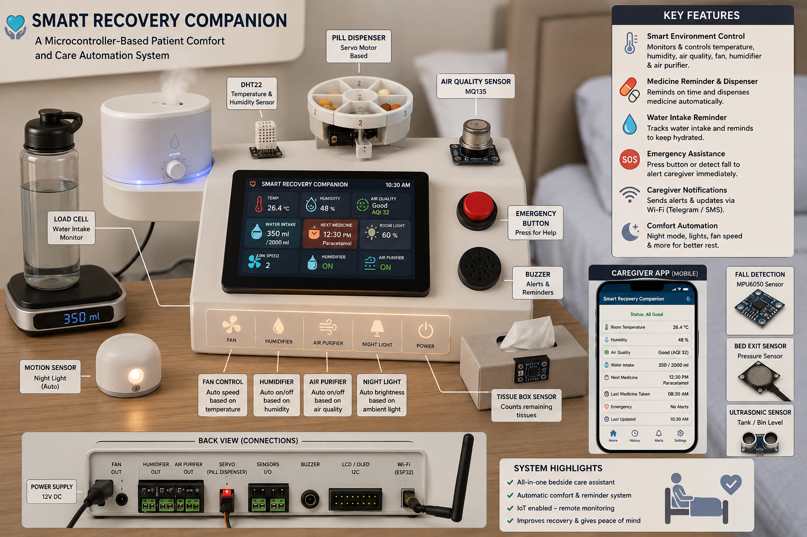

Slide 10

5. Components Used and Technologies
Component | Role | Qty
ESP32 Dev Board | Main controller — Wi-Fi + Bluetooth, runs all subsystem logic | 1
DHT22 | Room temperature & humidity sensing | 1
DS3231 RTC Module | Accurate real-time scheduling for medicine reminders | 1
SG90 Micro Servo | Rotates the pill-dispenser compartment disk | 1
HX711 + Load Cell | Weighs the water bottle to track hydration | 1
HC-SR04 Ultrasonic Sensor | Monitors humidifier tank / bin fill level | 1
MPU6050 Accelerometer | Detects sudden falls / impacts | 1
MQ135 Gas Sensor | General indoor air-quality sensing (optional) | 1
0.96" OLED (I2C, SSD1306) | Local status dashboard | 1
2-Channel Relay Module | Switches fan and humidifier | 1
Active Buzzer | Audible reminders & alarms | 1
Push Buttons | Emergency trigger / dose confirmation | 2
Mini Ultrasonic Humidifier | Humidity output actuator | 1
12V DC Fan | Cooling output actuator | 1
Technologies & Tools
Arduino IDE / C++
Firmware development for ESP32
I2C & One-Wire Protocols
OLED, RTC, and DHT22 communication
Wi-Fi (built-in ESP32)
Connectivity to internet services
Telegram Bot API / GSM SMS
Caregiver notification channel
Blynk / MQTT (optional)
Remote dashboard & mobile monitoring
Fusion 360 / Blender
Enclosure 3D design
KiCad / Fritzing
Circuit & wiring diagrams
Smart Recovery Companion
9

Slide 11

6. Expected Budget (LKR)
Based on current Sri Lankan electronics-retailer pricing (Duino.lk, Tronic.lk, Microchip.lk, RoboClub, Senith Electronics — mid-2026)
Item | Qty | Unit Price (LKR) | Subtotal (LKR)
ESP32 Dev Board | 1 | 1,250 | 1,250
DHT22 Sensor | 1 | 500 | 500
DS3231 RTC Module | 1 | 500 | 500
SG90 Micro Servo | 1 | 380 | 380
HX711 + Load Cell (5 kg) | 1 | 750 | 750
HC-SR04 Ultrasonic Sensor | 1 | 300 | 300
MPU6050 Accelerometer | 1 | 350 | 350
MQ135 Gas Sensor | 1 | 550 | 550
0.96" OLED Display | 1 | 650 | 650
2-Channel Relay Module | 1 | 400 | 400
Active Buzzer | 1 | 60 | 60
Push Buttons | 2 | 50 | 100
Mini Ultrasonic Humidifier | 1 | 1,500 | 1,500
12V DC Cooling Fan | 1 | 450 | 450
Jumper Wires / Prototyping PCB | 1 | 600 | 600
Enclosure Box (custom-cut) | 1 | 1,200 | 1,200
5V/2A Power Adapter & Wiring | 1 | 800 | 800
Miscellaneous (solder, connectors) | 1 | 500 | 500
Subtotal |  |  | 10,840
Contingency (~10%) |  |  | 1,060
Estimated Total |  |  | LKR 11,900
Budget Notes
Prices sourced from local SL electronics retailers, mid-2026.
Total per team (shared, not per student).
Excludes personal tools already owned (soldering iron, multimeter).
AliExpress imports are cheaper but add 2–4 week delivery and customs risk.
10

Slide 12
7. Work Distribution
5 members — each owns one sensor subsystem plus a shared hardware/software integration task
Member 1
Member 2
Member 3
Member 4
Member 5
Environmental Comfort Lead
Medicine Adherence Lead
Hydration Monitoring Lead
Safety & Emergency Lead
Integration & IoT Lead
DHT22 + Relay/Fan/Humidifier
DS3231 RTC + Servo Dispenser
HX711 + Load Cell
MPU6050 + Push Button + HC-SR04
ESP32 core + OLED + Wi-Fi
Hardware: wiring & relay safety · Software: threshold control logic
Hardware: dispenser mechanism · Software: scheduling & reminder firmware
Hardware: bottle-platform mount · Software: weight calibration & alerts
Hardware: sensor placement · Software: fall-detection threshold tuning
Hardware: enclosure assembly · Software: Telegram/SMS alerts, system integration, testing
All members jointly contribute to documentation, testing, and the final demonstration.
Smart Recovery Companion
11

Slide 13
8. Project Timeline
A 14-week, one-semester schedule — realistic for a 5-member team; moderate scope, not oversized
Wk 1–2: Literature review, requirement study, component procurement
Wk 3–4: Individual sensor breadboard prototyping & unit testing
Wk 5–6: Actuator wiring and control-logic coding per subsystem
Wk 7: Mid-progress review — individual subsystem demos
Wk 8–9: Full system integration on a single ESP32
Wk 10: Wi-Fi / Telegram / SMS notification layer
Wk 11: Enclosure design, assembly & wiring clean-up
Wk 12: End-to-end testing, calibration, bug-fixing
Wk 13: Report and documentation writing
Wk 14: Final demonstration & viva
Smart Recovery Companion
12

Slide 14
9. References
Espressif Systems, "ESP32 Series Datasheet," Espressif Systems, 2023.
Aosong Electronics, "AM2302/DHT22 Digital Temperature and Humidity Sensor Datasheet."
Analog Devices (Maxim Integrated), "DS3231 Extremely Accurate I²C-Integrated RTC/TCXO/Crystal Datasheet."
Avia Semiconductor, "HX711 24-Bit Analog-to-Digital Converter for Weigh Scales Datasheet."
R. Ahmad, H. M. Kaidi, M. N. Nordin, A. F. Ramli, M. A. Abu, and Y. Kadase, "Development of Blood Oxygen Level, Heart Rate and Temperature Monitoring System by Using ESP32," in Proc. ICSSA, IEEE, 2022, pp. 167–172.
I. G. T. Isa, M. I. Ammarullah, A. Efendi, Y. S. Nugroho, H. Nasrullah, and M. P. Sari, "Constructing an elderly health monitoring system using fuzzy rules and Internet of Things," AIP Advances, vol. 14, no. 5, 2024.
S. Rupasinghe and I. Maduranga, "IoT-based elderly activity monitoring system to support ambient assisted living," as cited in: IoT-Based Elderly Health Monitoring System Using Firebase Cloud Computing, PMC, 2024.
IJRASET, "IoT Based Smart Medical Kit Using ESP32," International Journal for Research in Applied Science & Engineering Technology, 2025.
IEEE Xplore, "IOT-Based Wireless Patient Monitor Using ESP32 Microcontroller," IEEE Conference Publication, 2024.
Smart Recovery Companion
13

